Slide 1
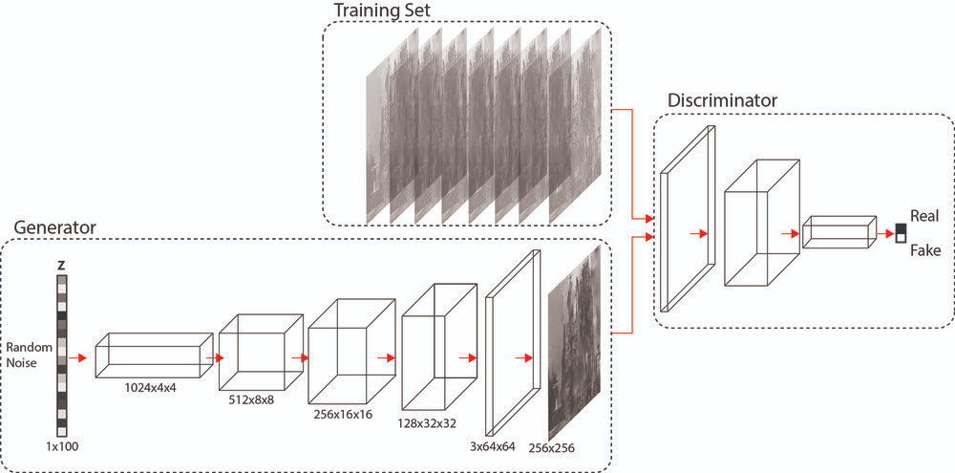
Single
Image Super Resolution
SRGAN

Slide 2
CONTENTS
Introduction
Problem statement
Motivation
Problem Domain
Dataset
Literature Review
Related work
Methodology Used
SRRESNET
SRGAN
Pipeline
LOSS
Metrics
Results
Future Work
Websites, Github and Pip Package
Documentation
Conclusion
Reference

Slide 3
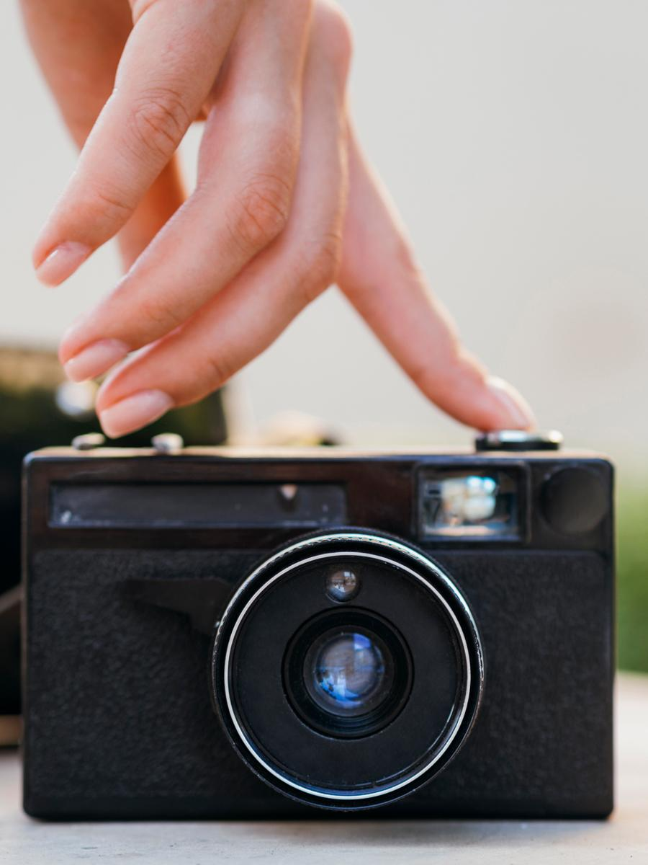
INTRODUCTION
Problem statement
Our Goal in this Project is to take a low resolution image and produce an estimate of a corresponding high‑resolution image.

Slide 4
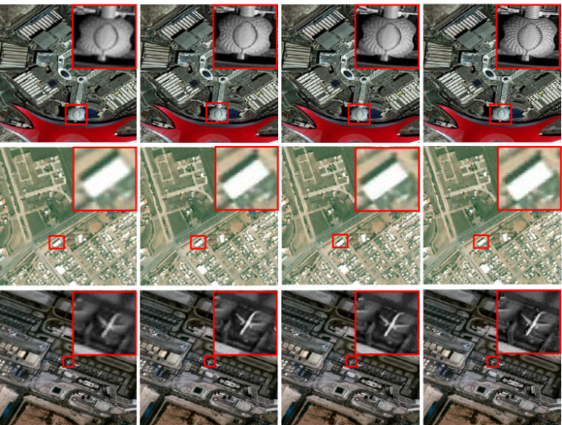
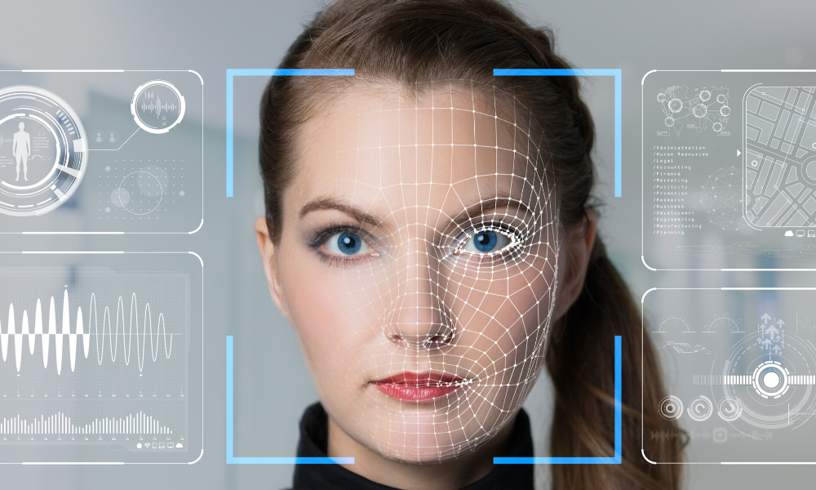
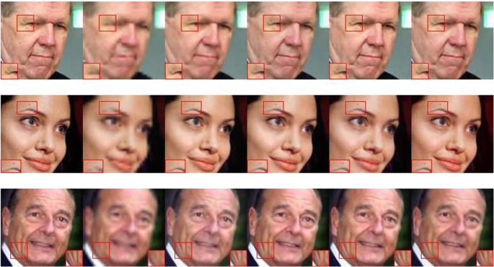

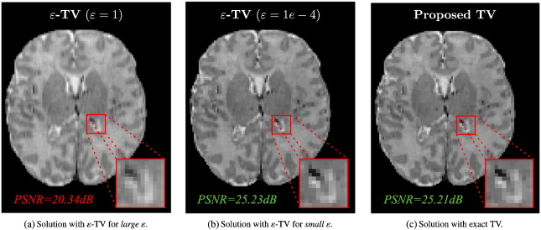
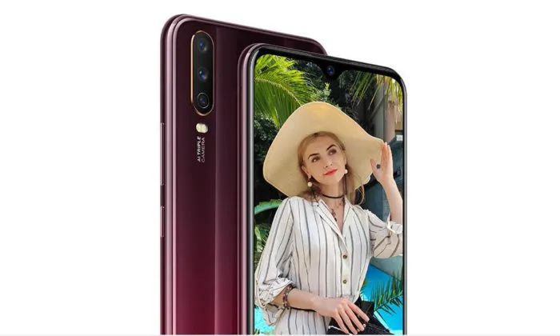
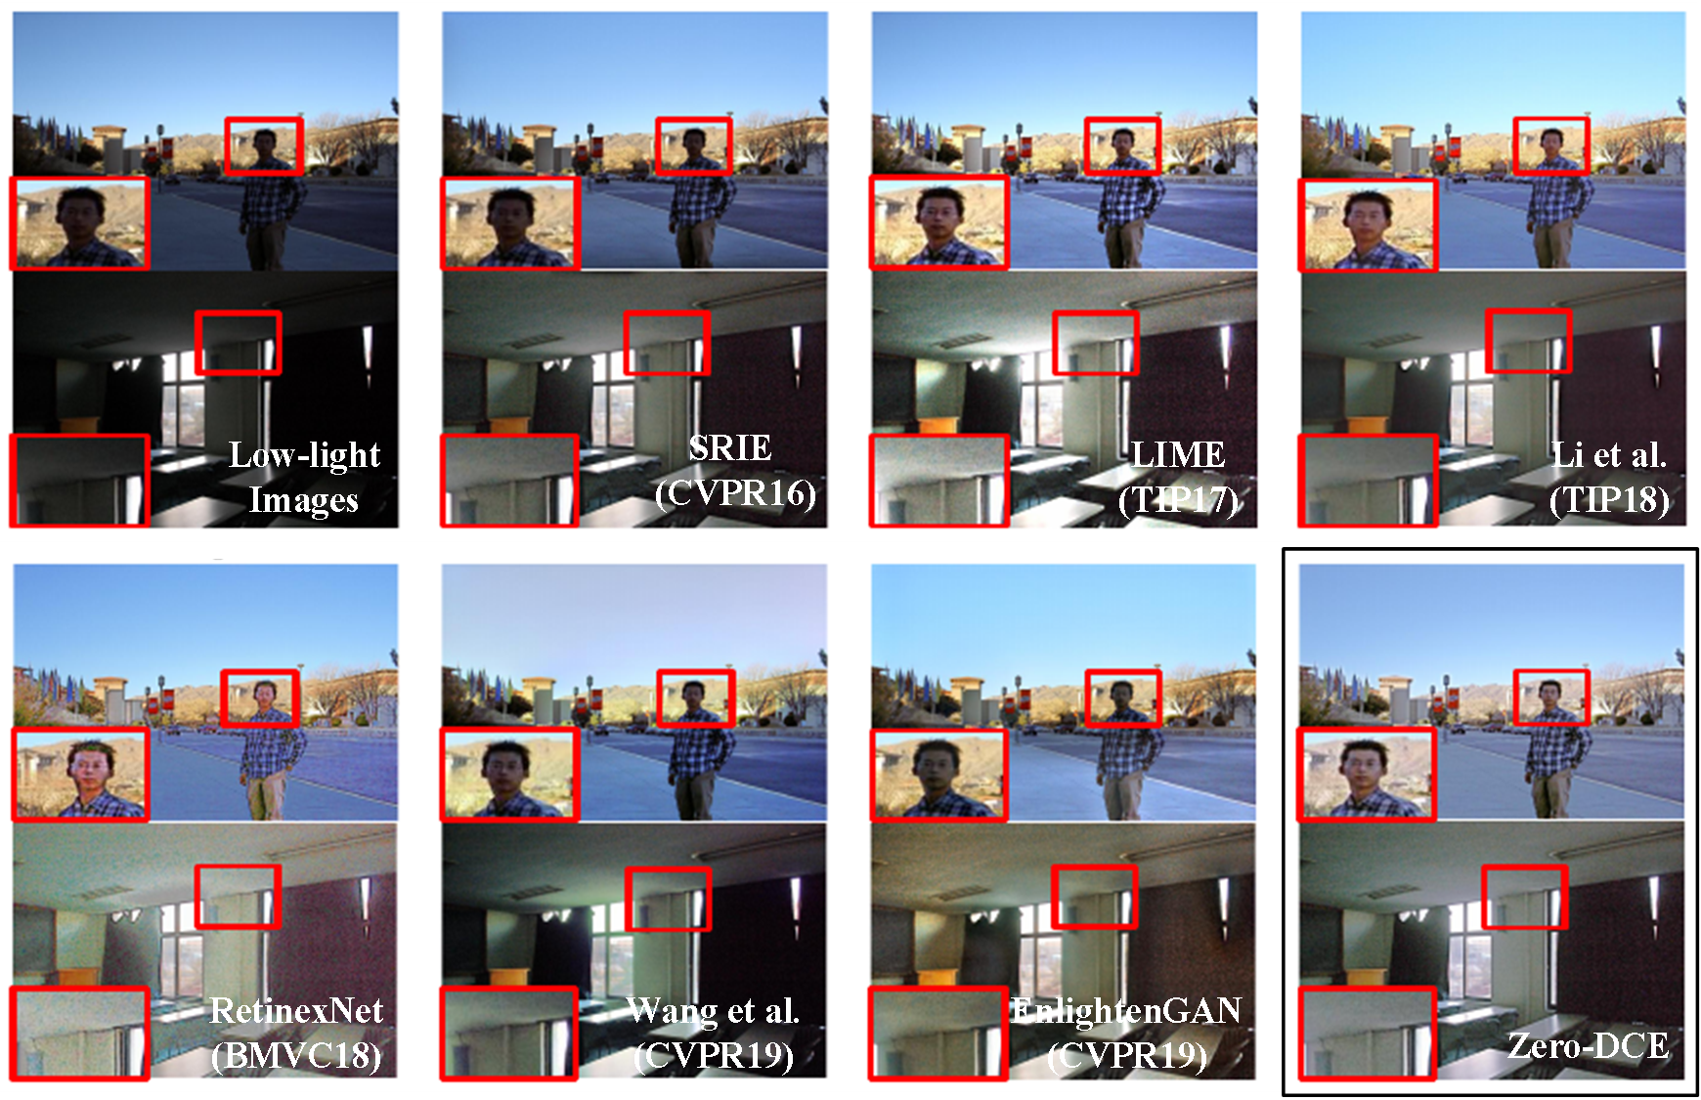
Satellite imaging
Face recognition
Motivation
Media content
Surveillance
Medical imaging
Video and Image enhancement
Smartphones

Slide 5

Problem Domain
Super-resolution is a task concerned with upscaling images from low-resolution sizes such as 64 x 64, into high-resolution sizes such as 256 x 256.
One solution to super-resolution is to train a Deep Convolutional Network that takes in data where the input is a Low-Resolution Patch and the labeled output is a High-Resolution Patch.

Slide 6
Datasets
DIV2K
Flickr2K
Other benchmark
800 train, 100 validation, and 100 test.
2K resolution images are provided, including both high and low resolution images with 2x, 3x, and 4x downscaling factors.
2650 2K images from FLICKR
Animal Faces ,Set5,Set14, BSD100, URBAN 100

Slide 7
Training Based Method
Traditional Filtering Methods
Neural network approaches
Literature Review
Image super-resolution can be separated into 3 groups:
Based on example-pairs rely on low-resolution (LR) training patches with high-resolution (HR) counterpart.
Basic filtering techniques
focused on edge-preservation
Using bicubic interpolation, to upscale LR input images to target spatial resolution before feed to deep neural network (SRCNN, VDSR, DRCN)
Loss function closer to perceptual similarity

Slide 8
Evaluation
the low resolution image is resized by a factor of 2x or 4x using some interpolation method like nearest-neighbor, bilinear or bicubic method of interpolation.
first the image is upsampled using bicubic interpolation and then feed to a simple FCNN.there is no pooling operations involved.we compute the MSE loss between the target HR image with the output.
(CNN with skip connections) are better than conventional CNNs. SRResNets replaced simple convolution blocks with residual blocks. As a result accuracy increased significantly.
Interpolation
SRCNN
SRResNet
Perceptual Loss
SRGAN
Perceptual loss is computed by comparing two images based on high-level representations from pre-trained CNN model. The function is used to compare high level differences, like content and style discrepancies, between images.
SRGAN is a GAN based network, where the generator (G) learns to generates SR images from LR images as close as possible to HR. The discriminator (D) learns to distinguish generated SR images from real images.

Slide 9
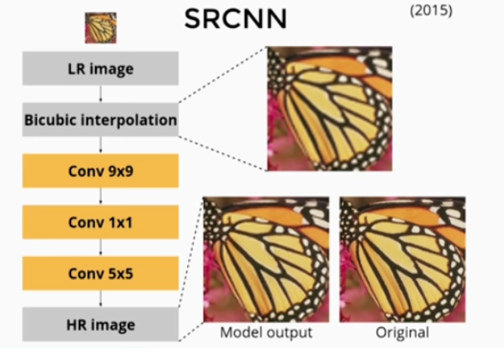
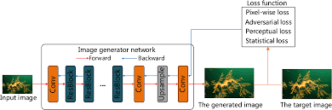
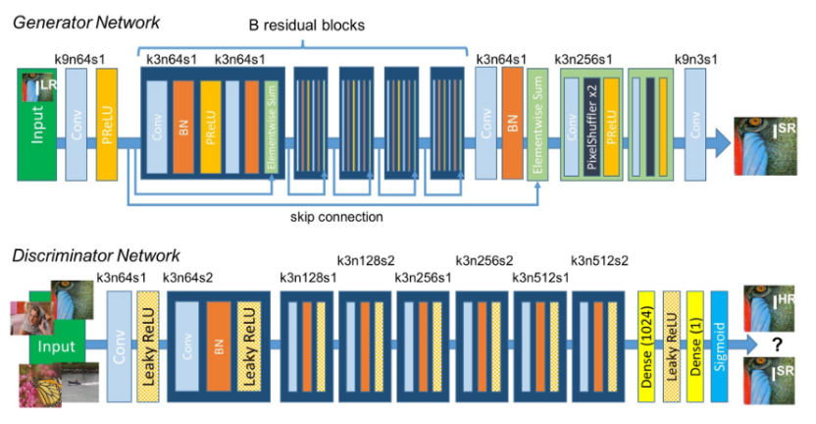
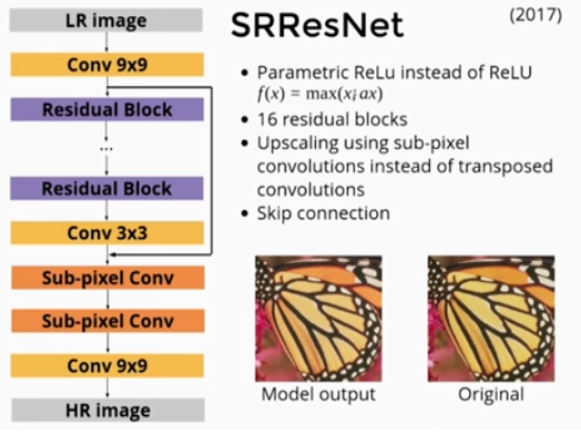
SRCNN
Perceptual Loss
SRResNet
SRGAN

Slide 10
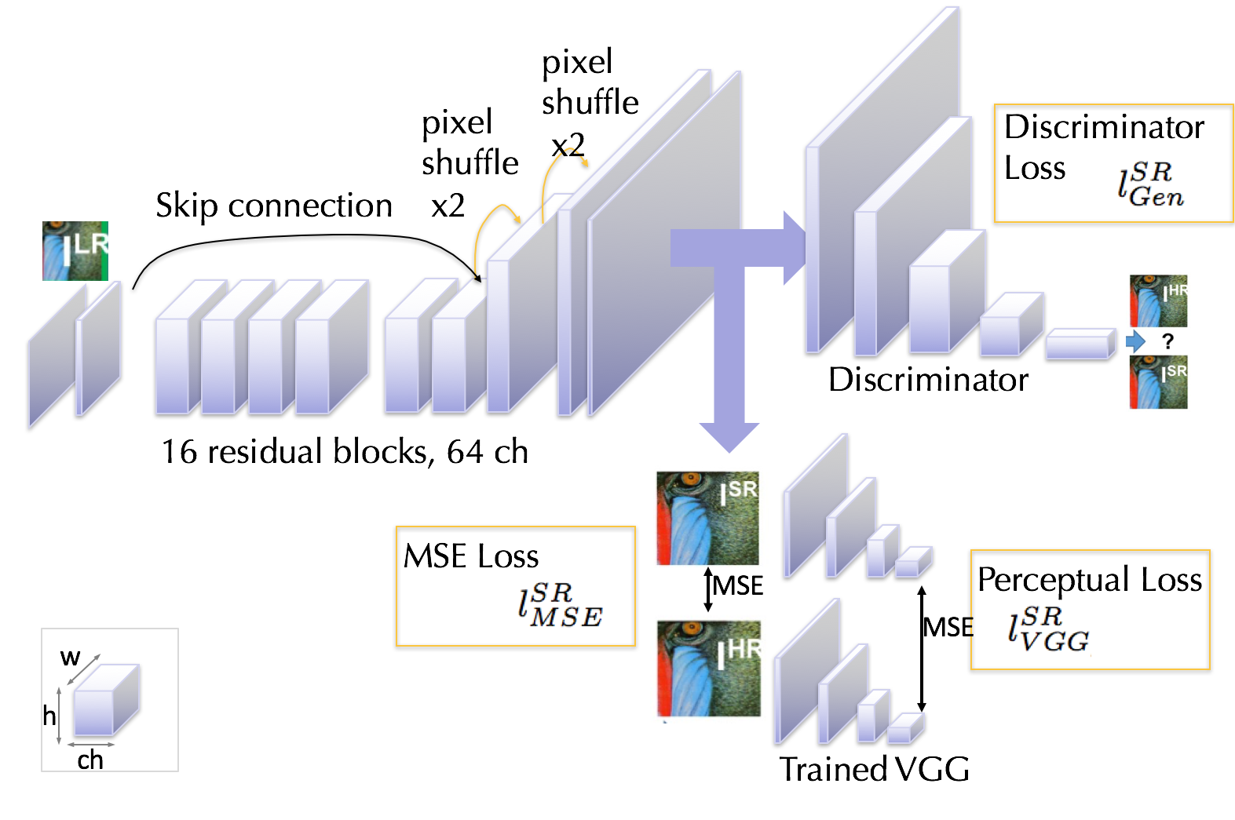
Methodology Used
SRResNet
CNN with skip connections
SRResNets replaced simple convolution blocks with residual blocks.

Slide 11

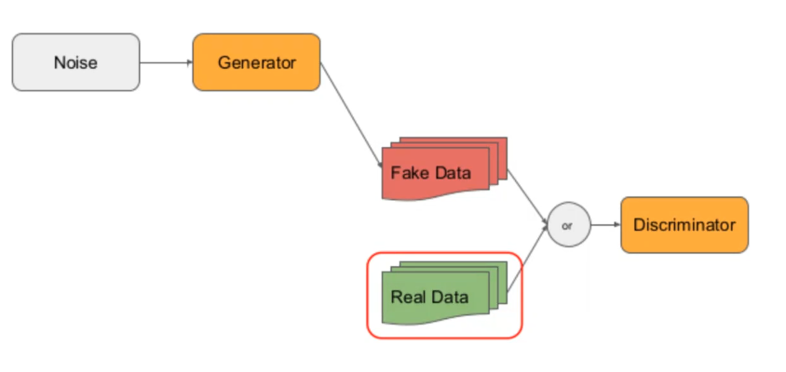
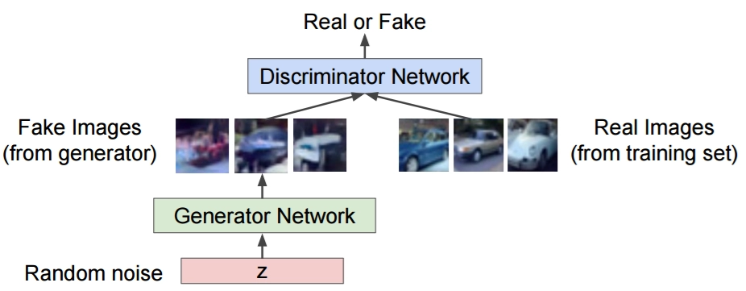

Methodology Used
SRGAN
SRGAN has three neural networks, a generator, a discriminator, and a pre-trained VGG19 network on the Imagenet dataset.

Slide 12
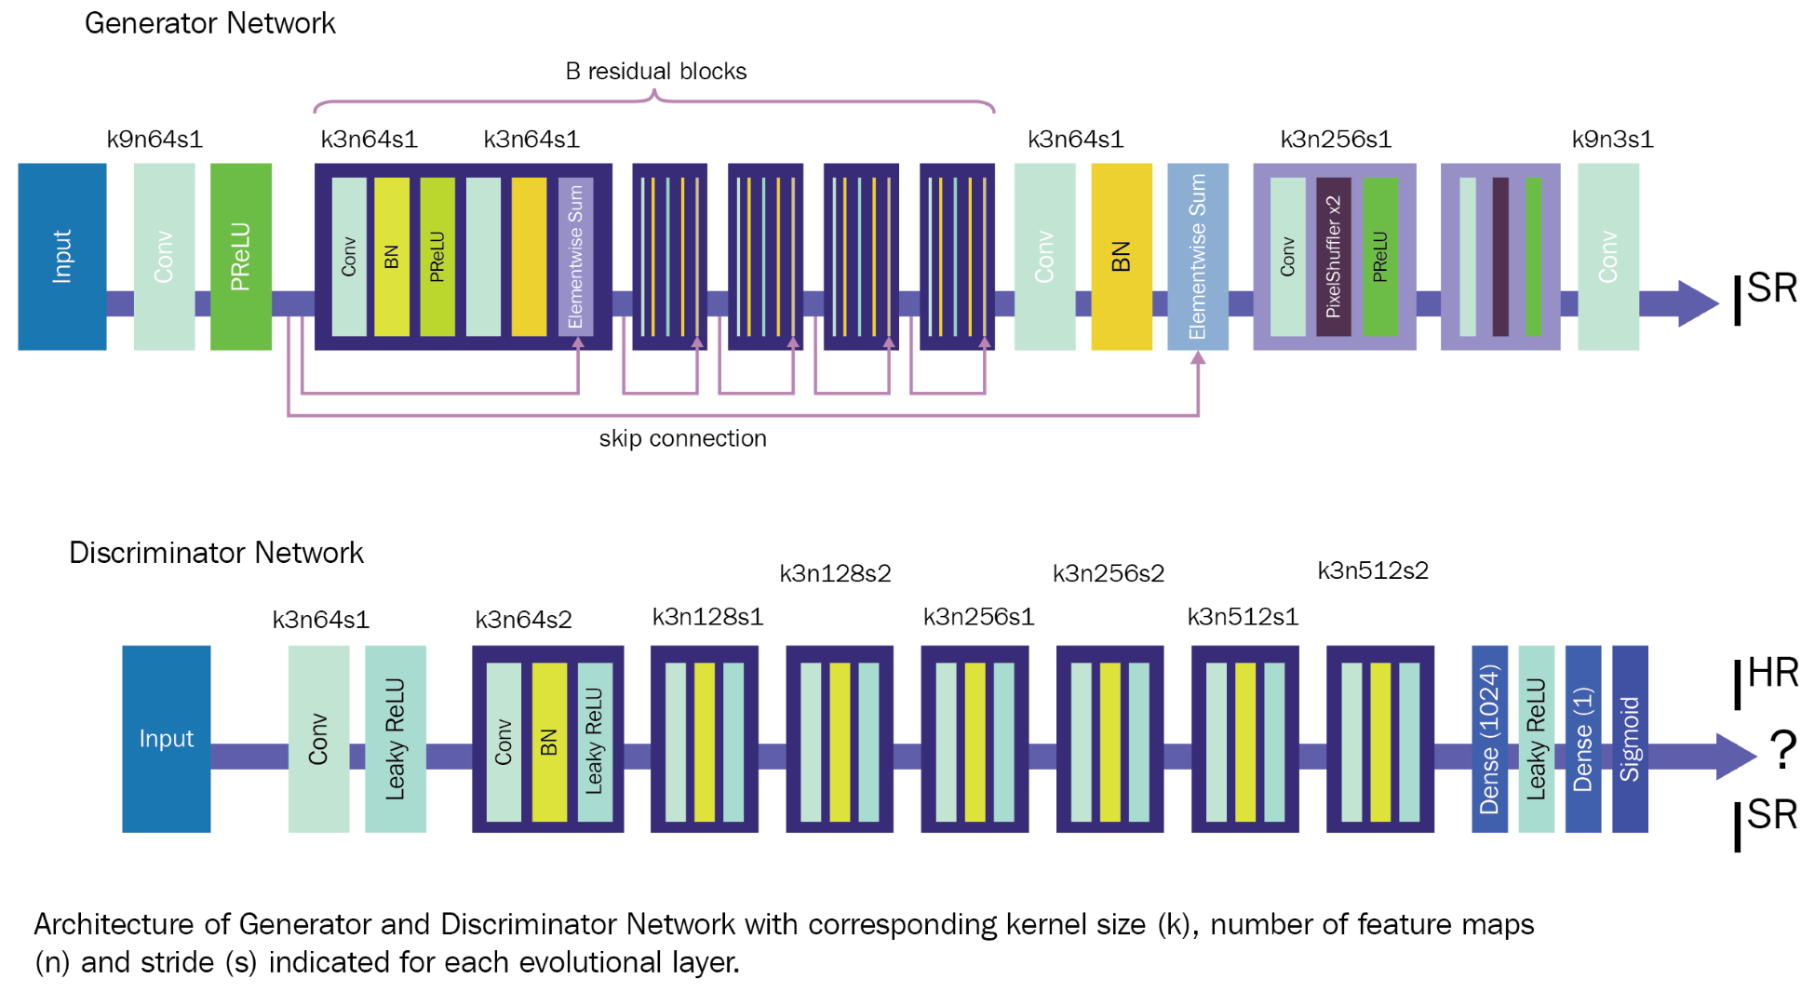
The architecture of SRGANs
In SRGANs, both of the networks are deep Convolution neural networks.
They contain convolution layers and upsampling layers.
Each convolution layer is followed by a batch normalization operation and an activation layer.

Slide 13
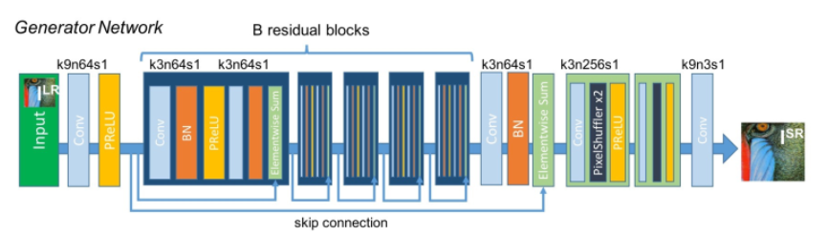
Generator
hyperparameters:
residual_blocks = 16
momentum = 0.8
input_shape = (64, 64, 3)

Slide 14
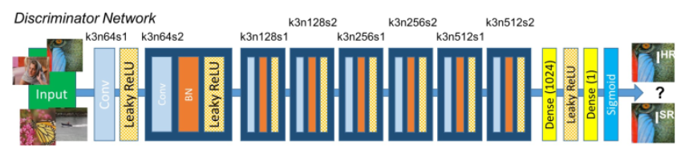
DISCRIMINATOR
hyperparameters:
leakyrelu_alpha = 0.2
momentum = 0.8
input_shape = (256, 256, 3)

Slide 15
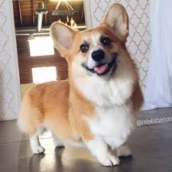
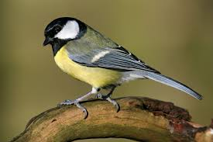
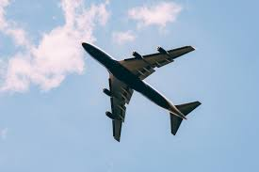
PIPELINE
SRGAN Training Phase
Real/Fake?
Discriminator
Backpropagation
Generator
(Upsample)
Downsample
ImageNet Train
Notes:
We downsample to represent LR images, and upsample with pixel shuffle

Slide 16
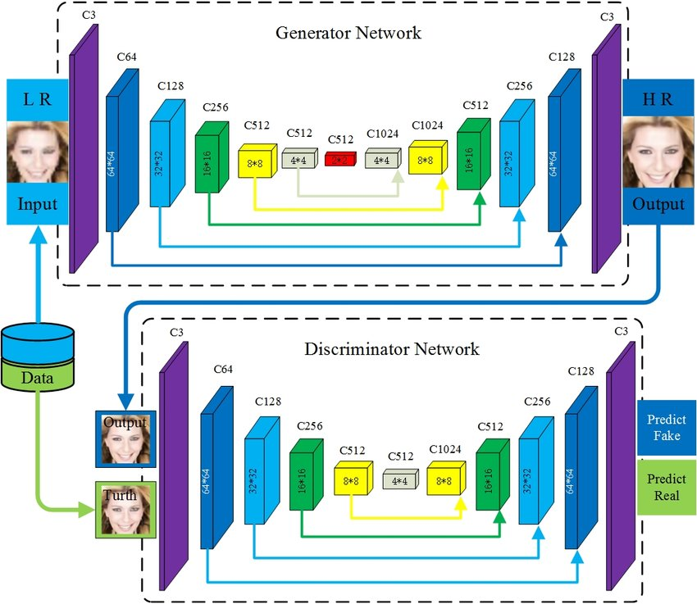

Slide 17
Loss Functions
L2, L1, or some difference metric is used to evaluate the model.
Training with pixel loss optimizes PSNR, but doesn't directly optimize the perceptual quality,
Perceptual loss tries to match the high-level features in a generated image with a given HR output image.
This is achieved by taking a pre-trained network, like VGG, and using the difference of feature outputs between predicted and output images as loss.
This loss function is used in LapSRN instead of the generic L2 loss.
The results show that Charbonnier loss deals better with outliers and produces sharper images compared to those generated with L2 loss, which are generally smoother.
Pixel Loss
Perceptual Loss
Charbonnier Loss
Texture Loss
Adversarial Loss
this loss function tries to optimize the Gram matrix of feature outputs inspired by the Style Transfer loss function.
This loss function trains the network to capture the texture information in a HR image.
Used in all GAN-related architectures, adversarial loss helps in fooling the discriminator and generally produces images which have better perceptual quality.
ESRGAN adds an extra variant of this by using the relativistic discriminator, and thus instructing the network not only to make fake images more real, but also to make real images look more fake.

Slide 18
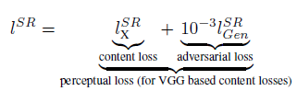
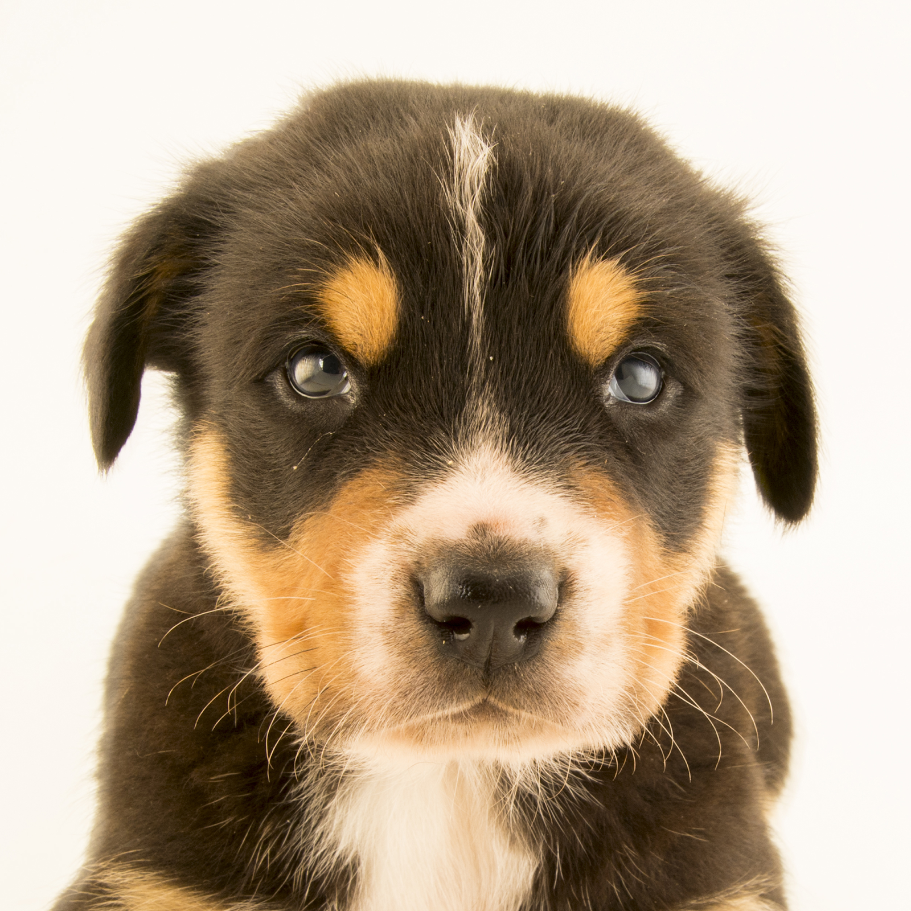
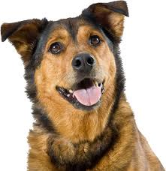
Adversarial loss for original GAN
Adversarial & content loss
Adversarial loss
Use images to explain what content loss is
LR
LR
Generated
Generated
Notes:
Apart from Adversarial Loss, which simply takes into consideration the “naturalness” of the image, it does not take into consideration whether the generator will generate an image that is similar to the LR image
(note that discriminator loss function is still the same)

Slide 19
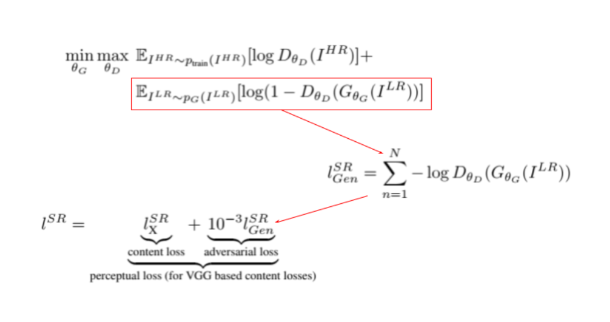
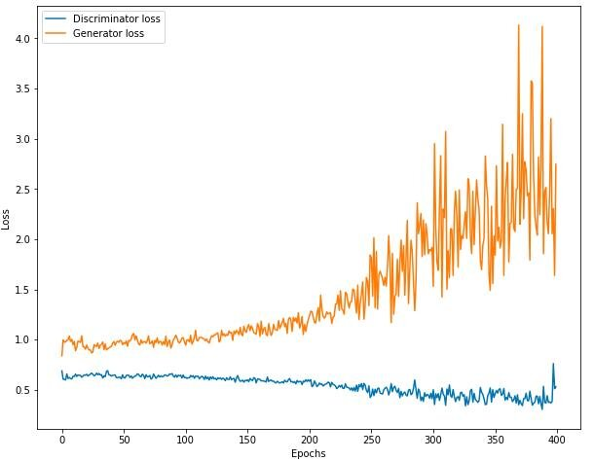
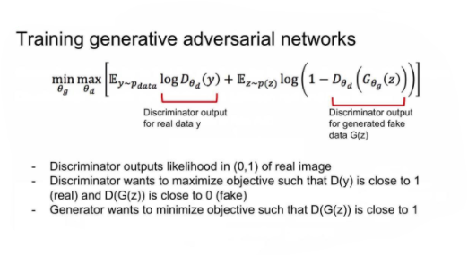

Slide 20
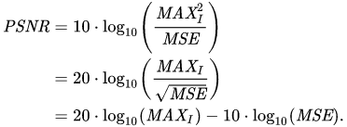
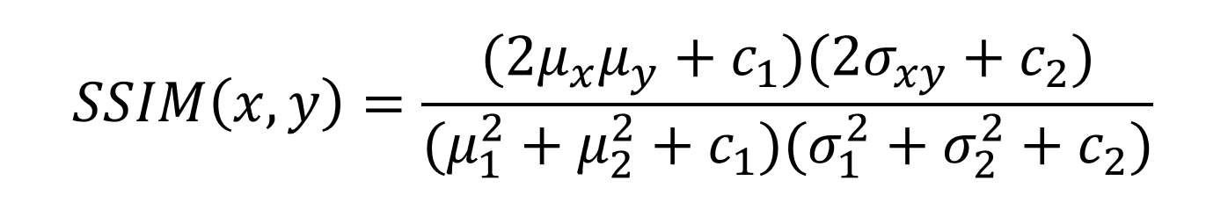
Metrics
Peak Signal to Noise Ratio is the most common technique used to determine the quality of results.
The signal in this case is the original data, and the noise is the error Caused by preprocessing on the image.
This metric is used to compare the perceptual quality of two images using the formula below, with the mean,variance and correlation of both images.
Mean Opinion Score is a manual way to determine the results of a model, where humans are asked to rate an image between 0 and 5. The results are aggregated and the average result is used as a metric.
PSNR
SSIM
MOS

Slide 21
Comparison between Different Models In Result Section
ONE ClASS VS MULTIPLE CLASS
IN ONE CLASS:
WE USED A CAT CLASS FROM ANIMAL FACES DATASETS
IN MULTIPLE CLASS:
WE USED A DIFFERENT CLASSES OF DATASET LIKE DIV2K ,FLICKR2k And Anothers OST IMAGES

Slide 22
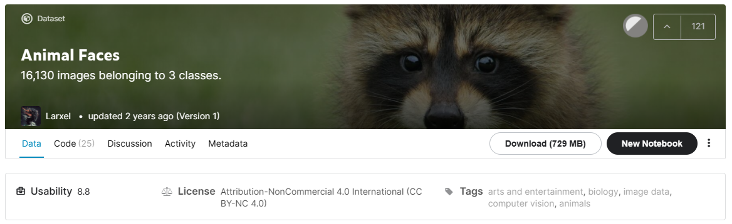
ONE ClASS VS MULTIPLE CLASS
IN ONE CLASS:
This dataset contains multiple class like dog ,cats and wild animals

Slide 23

ONE ClASS VS MULTIPLE CLASS
IN MULTICLASS:
This dataset contains multiple Datasets like DIV2K ,Flickr2K and OST IMAGES each one of those Datasets contains multiple classes of data - 3650 Images

Slide 24
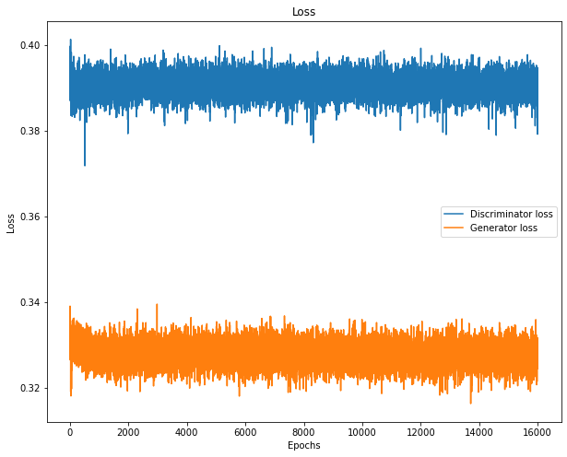
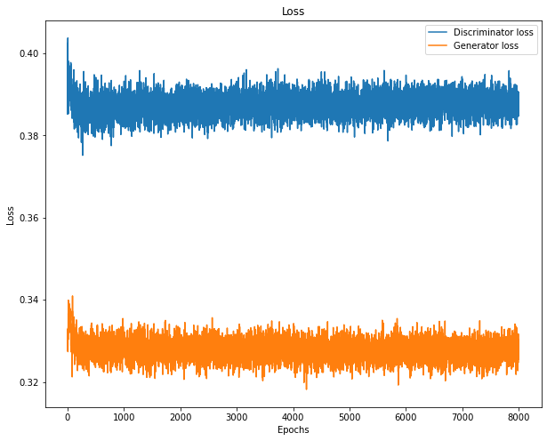
Generator and Discriminator Loss
ONE CLASS :
Epochs: 16000
Epochs: 8000

Slide 25
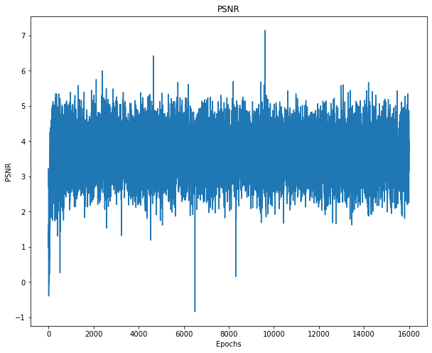
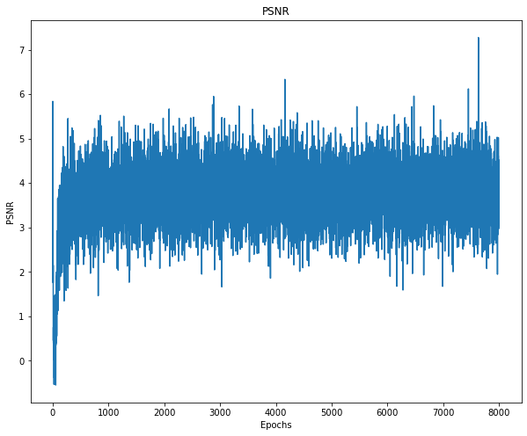
PSNR LOSS
Epochs: 16000
Epochs: 8000

Slide 26
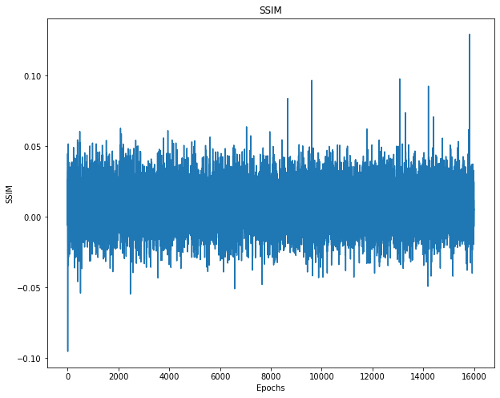
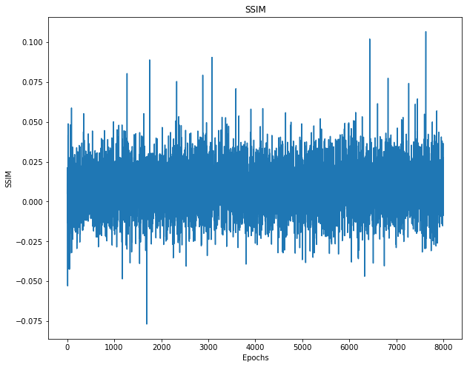
SSIM LOSS
Epochs: 16000
Epochs: 8000

Slide 27
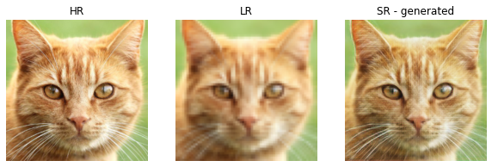
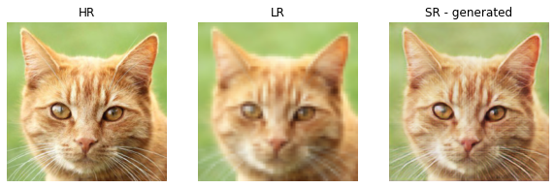
VISUAL COMPARE
Epochs: 16000
Epochs: 8000

Slide 28
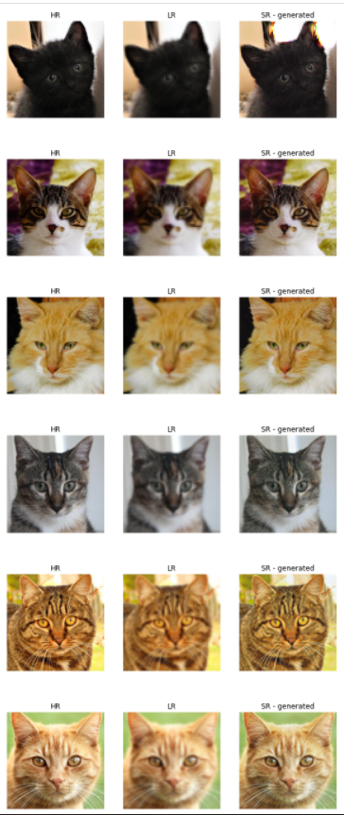
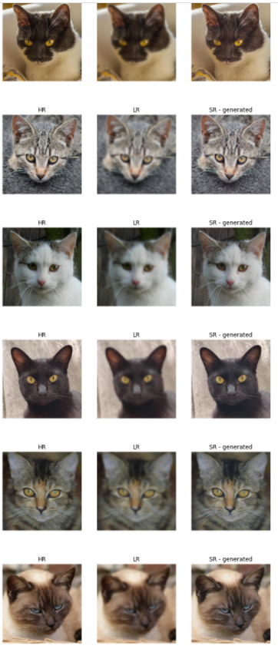
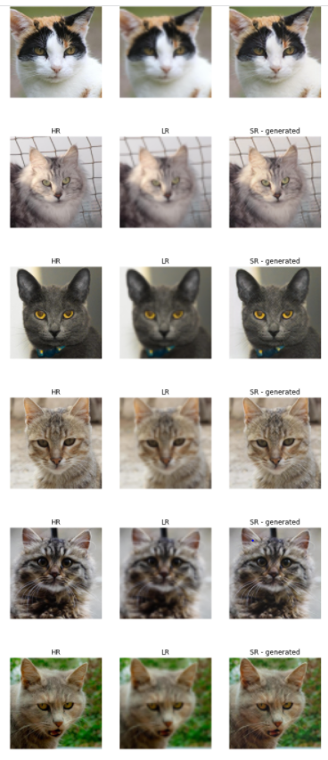
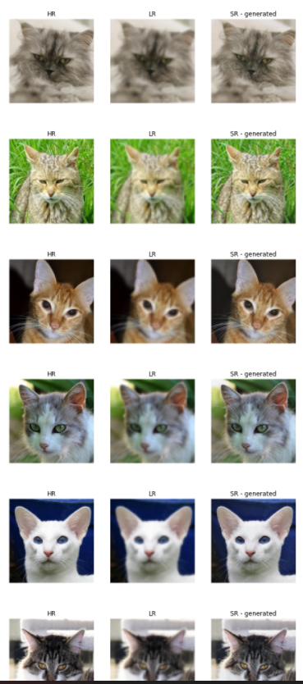

Slide 29
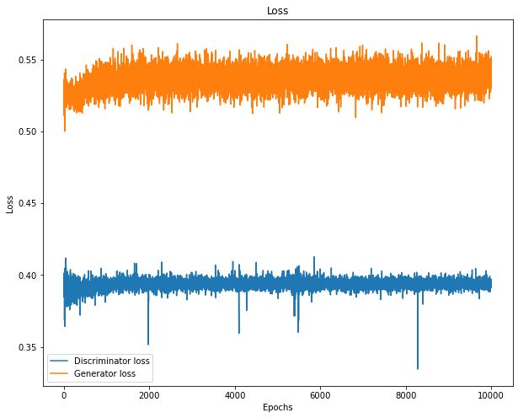
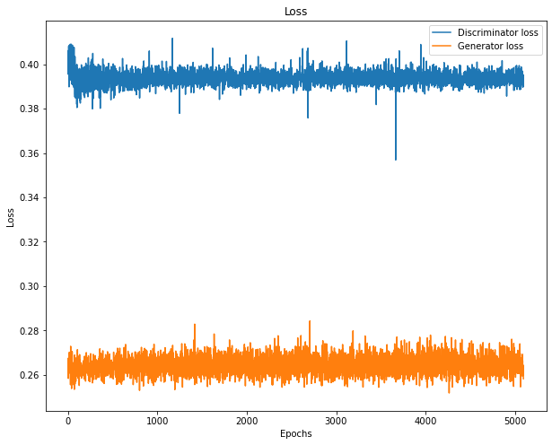
Generator and Discriminator Loss
MULTIPLE CLASS :
Epochs: 10000
Epochs: 5000

Slide 30
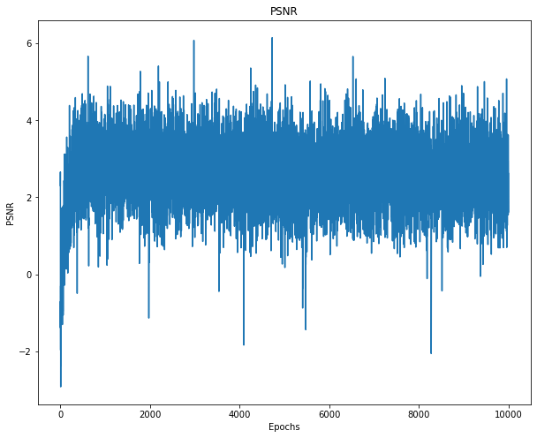
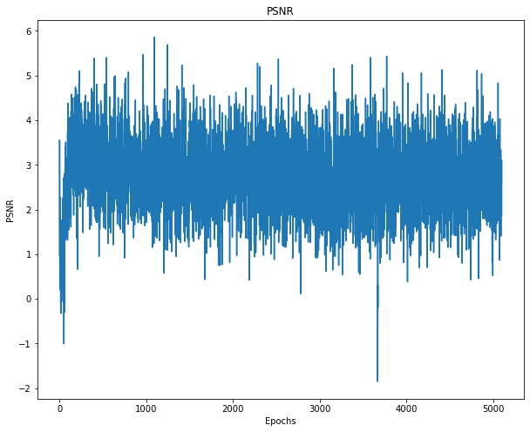
PSNR LOSS
Epochs: 10000
Epochs: 5000

Slide 31
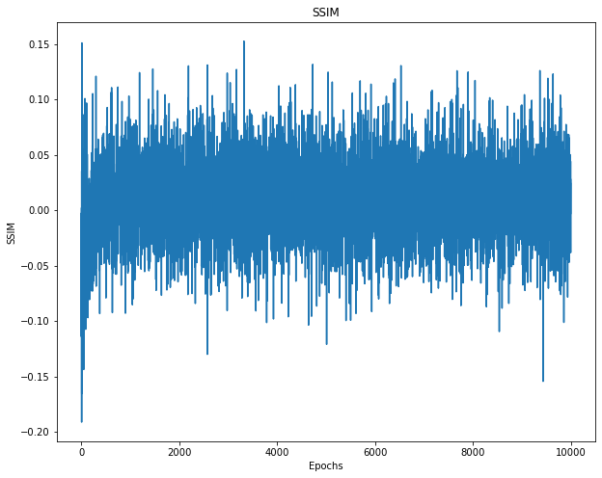
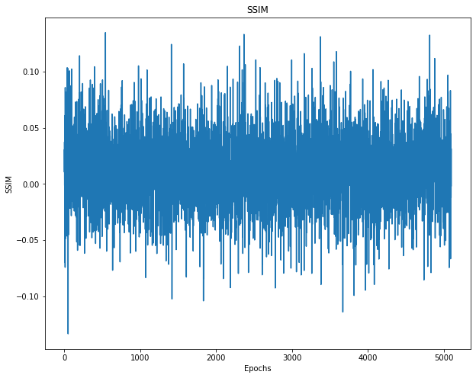
SSIM LOSS
Epochs: 10000
Epochs: 5000

Slide 32
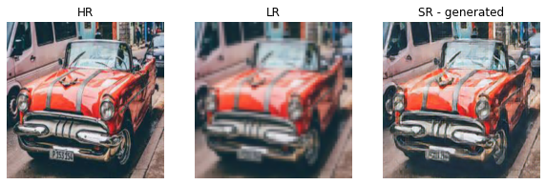

VISUAL COMPARE
Epochs: 10000
Epochs: 5000

Slide 33





Slide 34


Slide 35

Future Work - Real time image Super Resolution
Video streaming server
Client computer
Downsample
Web Transfer
Upsample
Original video
LR video
LR video
SR video
Notes:
For possible future work, we intend to look at real time image superresolution. There are many possible applications of video super resolution, for instance, where video streaming providers such as Netflix can stream lower quality videos and have the receiving client upsample the videos. This would allow reduced bandwidth usage, reducing storage and streaming costs on both client and server. Currently, the generator network adpots the ResNet style of model, with many sequential residual blocks. We could possibly look at having parallel convolutional layers to decrease the bottleneck, and increasing the speed of generating higher resolution images.

Slide 36


Slide 37


Slide 38

Websites and Github

Slide 39


Documentation

Slide 40
Conclusion
Single-image super-resolution is a challenging research problem with important real-life applications.
The phenomenal success of deep learning approaches has resulted in rapid growth in deep convolutional network based techniques for image super-resolution.
We implement both CNN and SRGAN architectures on the DIV2K dataset in very similar hyperparameter settings and compare the result side by side.
We find that gan models generate more visually pleasing images than CNN models.
Then we focus on GAN and experiment with different GAN architectures within SRGAN framework .
we have successfully integrate SRGAN model and successfully deploy it .
we found in experiment that when we trained on single class is better than when we train our model with multiple data classes .

Slide 41

References
Jaffe, Luke, Shiv Sundram, and Christian Martinez-Nieves. "Super-Resolution to Improve Classification Accuracy of Low-Resolution Images."
Ledig, Christian, et al. "Photo-realistic single image super-resolution using a generative adversarial network." arXiv preprint (2016).
Goodfellow, Ian, et al. "Generative adversarial nets." Advances in neural information processing systems. 2014.
1909.07113.pdf (arxiv.org)
Image Super Resolution | Deep Learning for Image Super Resolution (analyticsvidhya.com)
Using SRGANs to Generate Photo-realistic Images [Tutorial] | Packt Hub (packtpub.com)
https://medium.com/analytics-vidhya/super-resolution-with-srresnet-srgan-2859b87c9c7f
https://blog.paperspace.com/image-super-resolution/
SRGAN_Paper.pdf - Google Drive

Slide 42

THANKS!
Do you have any questions?

